Slide 1
8 Puzzel Game

Slide 2
Group Members
1.Fariha Hossain – 011143017
Sakib Shahriar Khan - 011143138

Slide 3
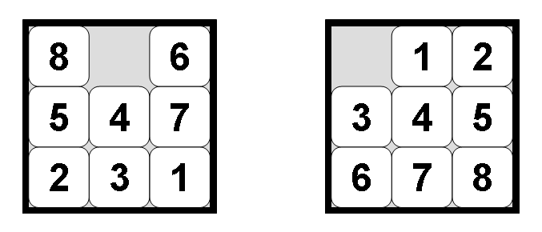
What Is 8 Puzzel Game?

Slide 4
Functionality
Keeps track of every tiles
Check in each step
Count Steps

Slide 5
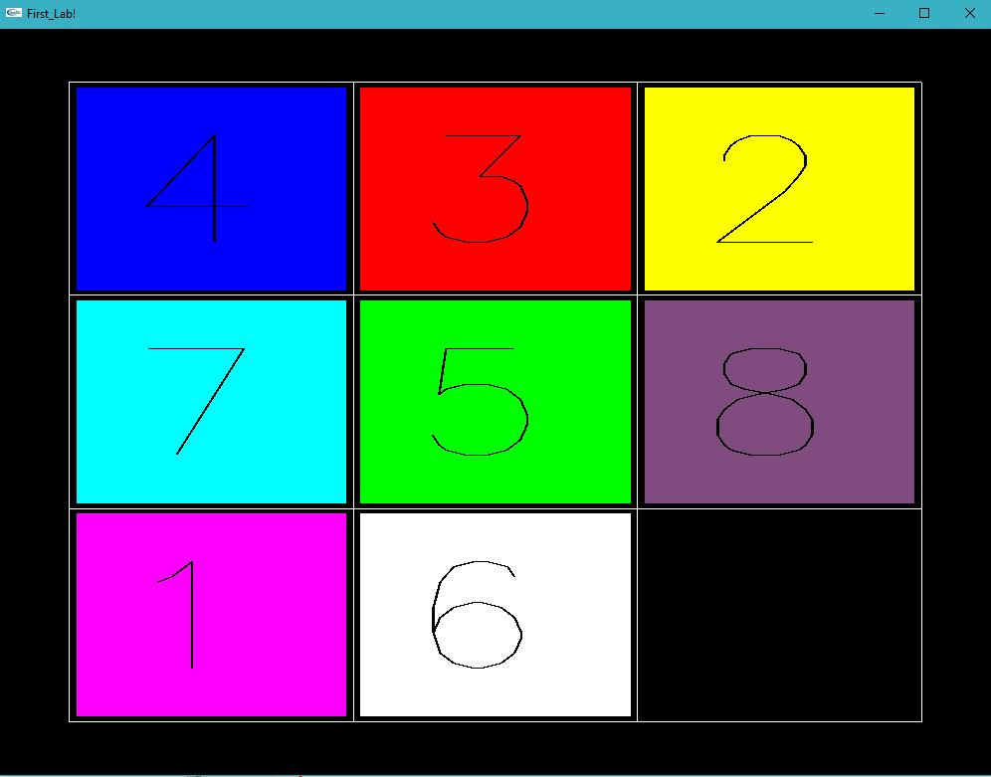
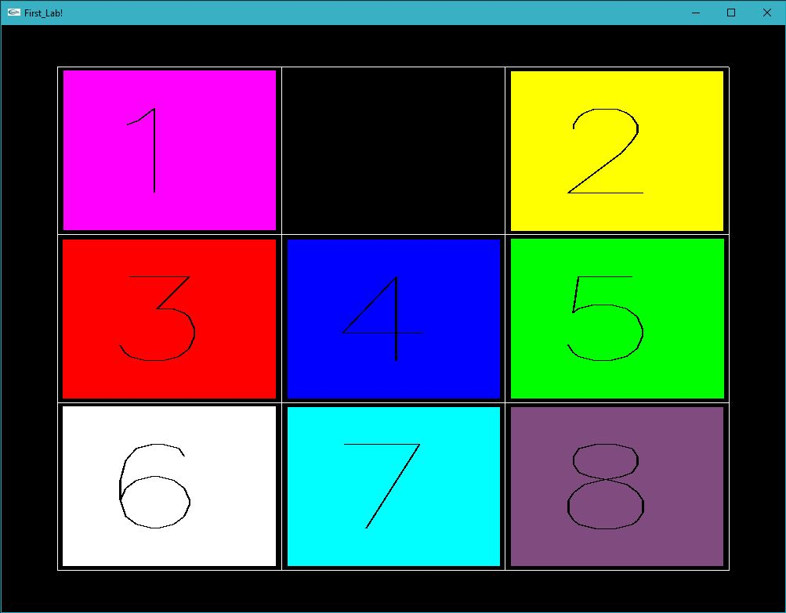
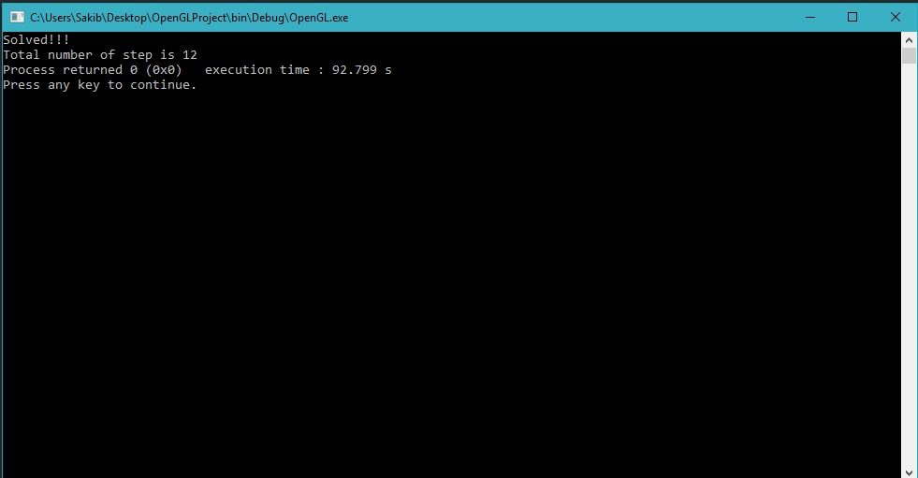
Screenshots

Slide 6


